Slide 1
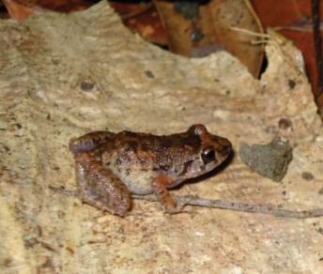
Diet of Greenhouse Frogs in different places

Slide 2
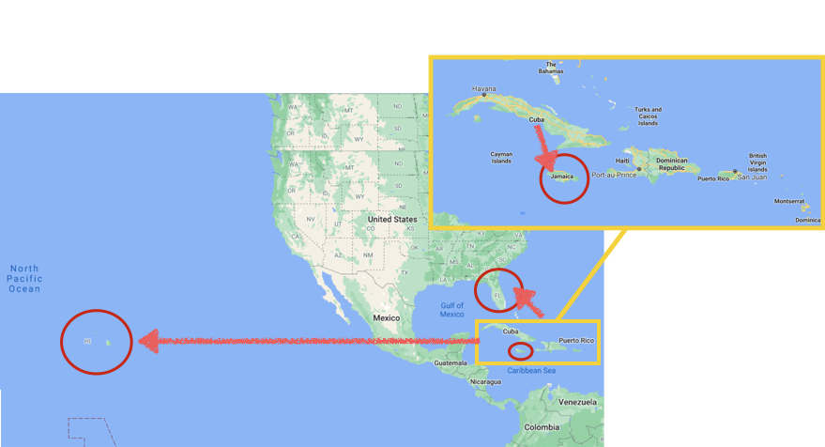
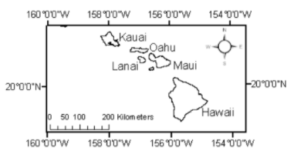
+title
Notes:
Cuba, the Cayman Islands, the Bahama Islands, San Salvador, and many other Caribbean islands,
invaded southeastern United States
Hawaii (1994) through nursery trade

Slide 3
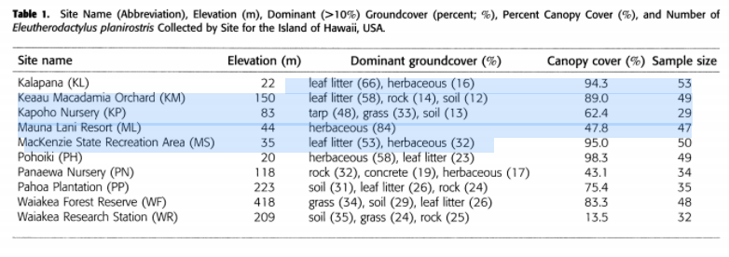
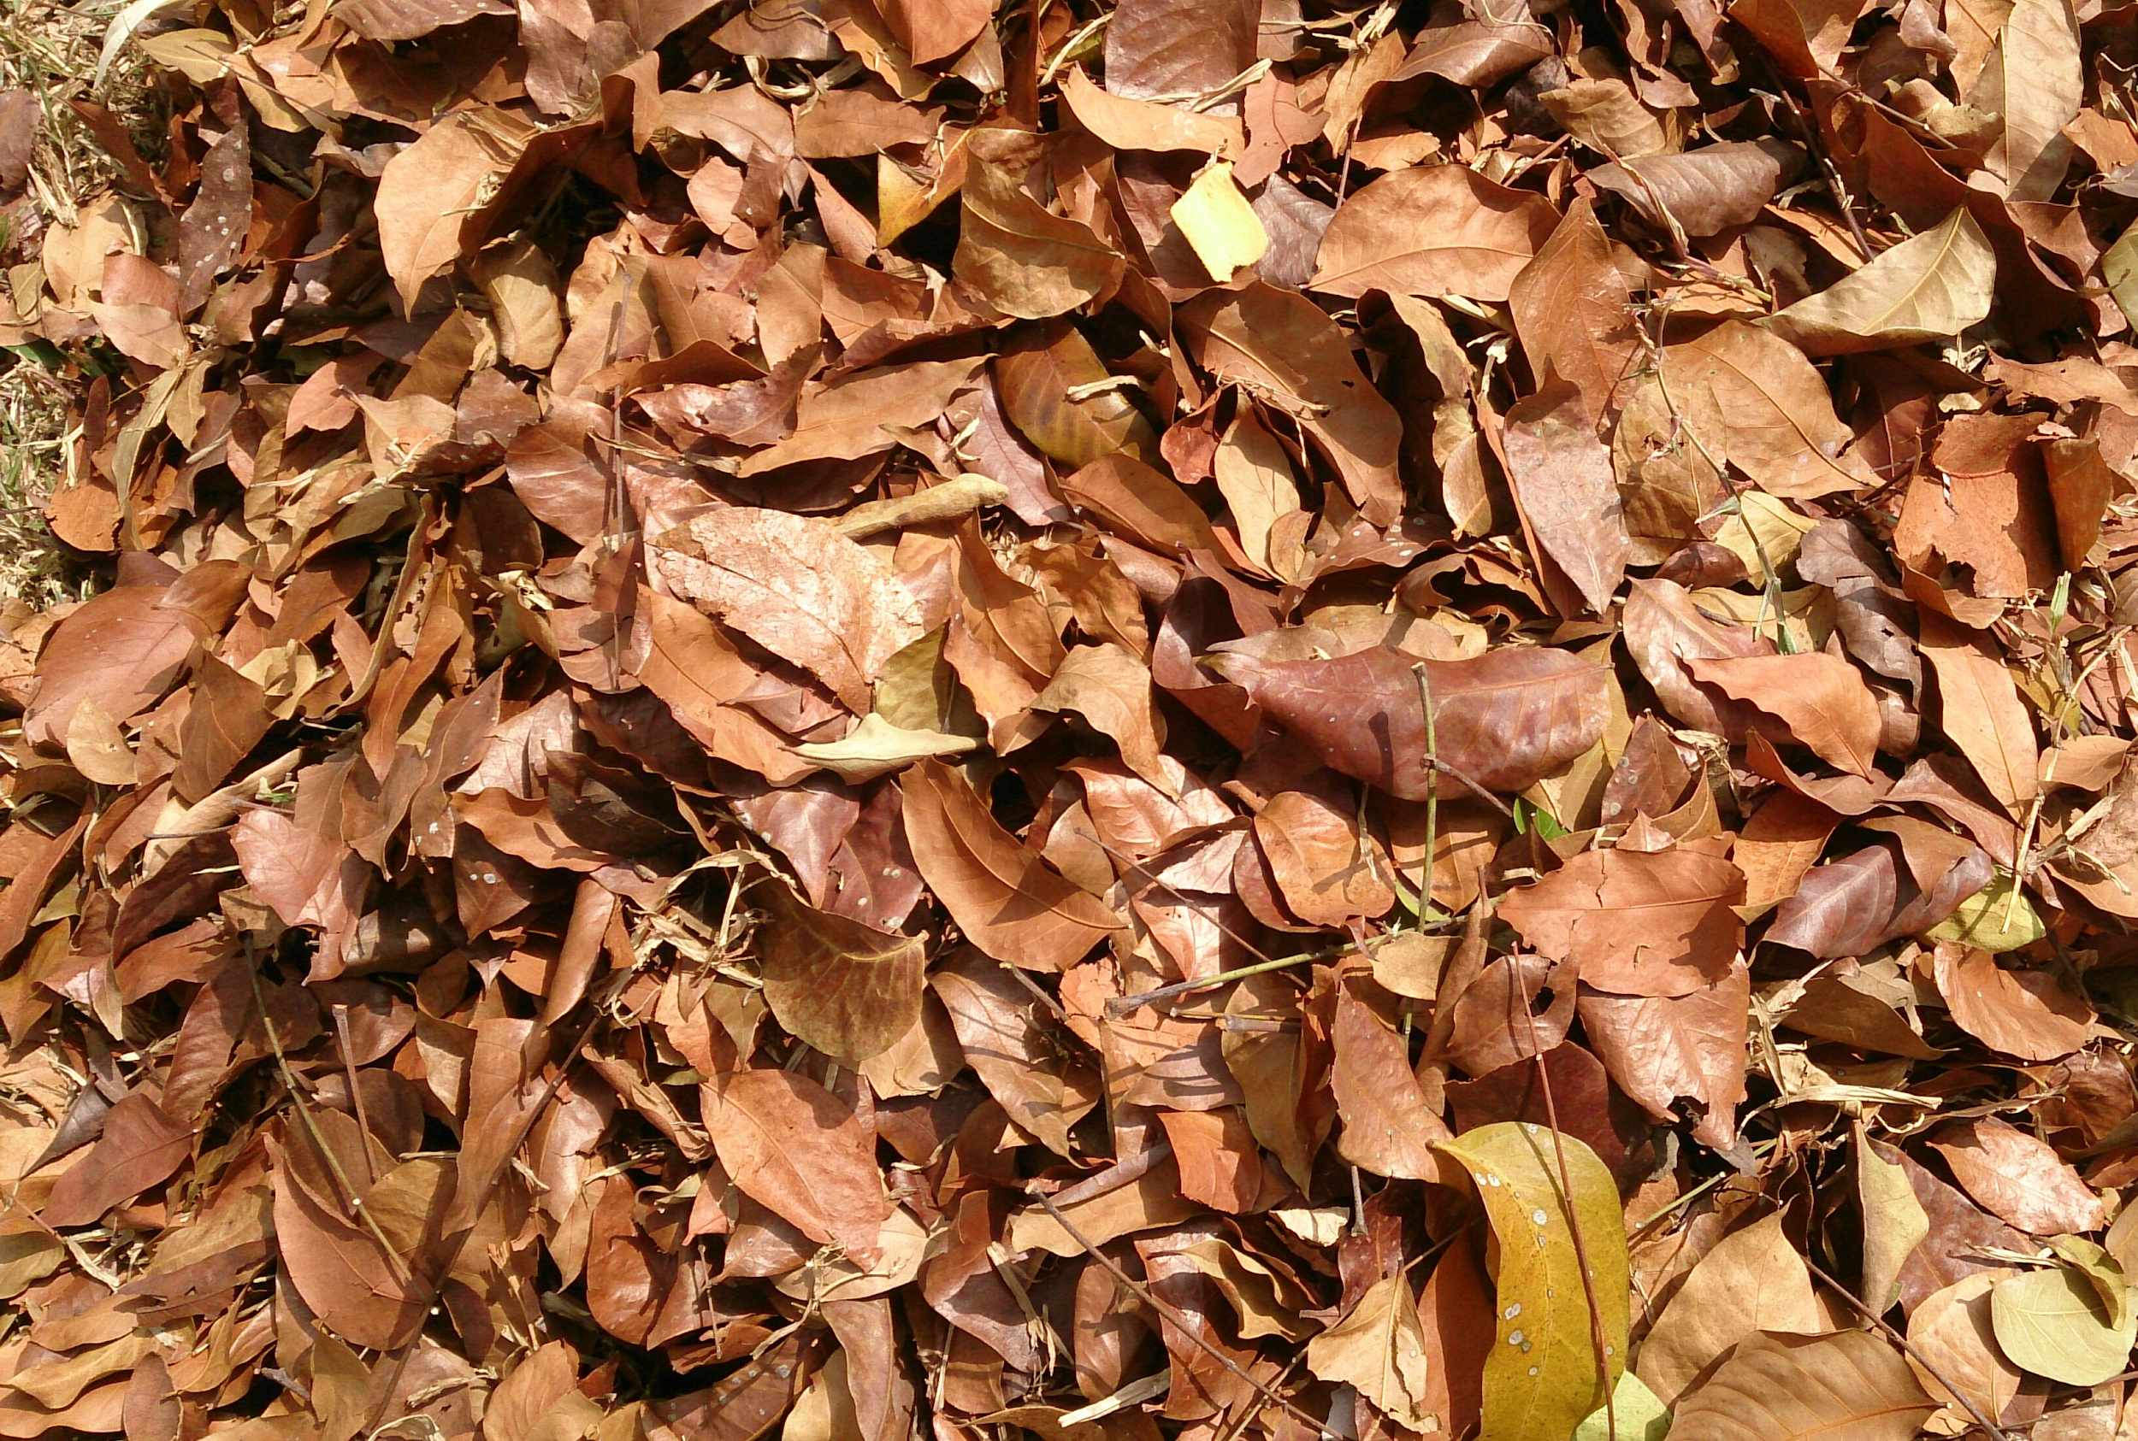
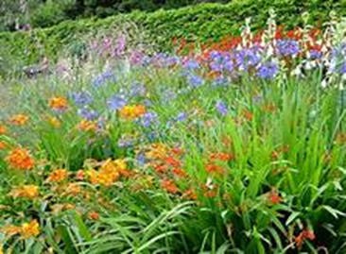
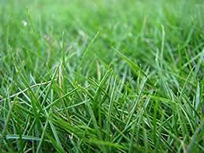
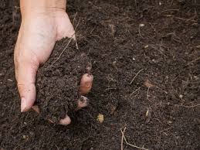
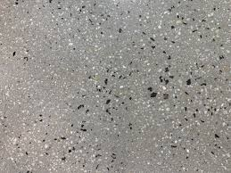
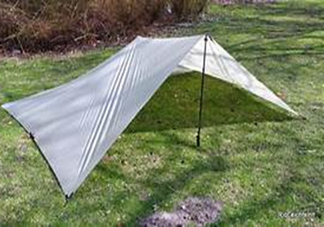
Microhabitat
change to picture
(micro habitat)
Leaf litter sample
Sticky trap
Vaccum
Leaf litter
Herbaceous
Grass
Soil
Concrete / Rock
Trap
Notes:
leaf litter from eight 0.25 x 0.25-m subplots, a minimum of 10 m apart, located randomly within a 100 x 100-m plot
Collected flying invertebrates on 10 x 18-cm sticky traps posted on stakes 10 cm above the forest floor. We randomly placed eight sticky traps, spaced a minimum of 10 m apart, within a 100 x 100-m plot for 48hr
we collected foliage invertebrates with the use of a modified insect vacuum, swept the insect vacuum across foliage below 0.50-m height of total time of 30 sec in each sub pot.

Slide 4
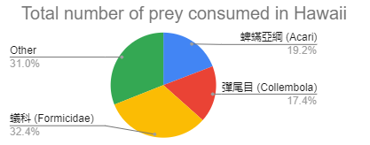
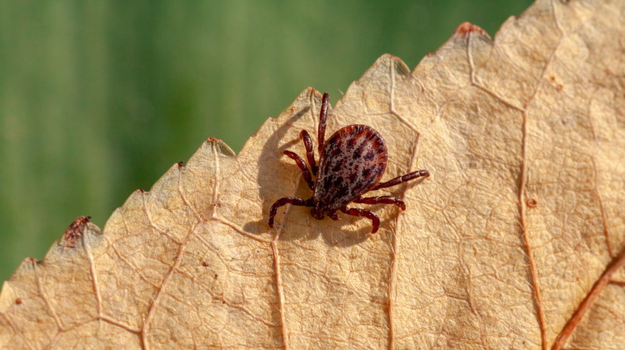
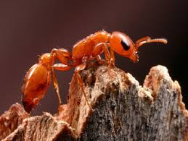
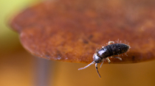



Diet in different countries
keep the pie chart and pictures
ants % in other location
Estimated to consume up to 129,000 invertebrates ha⁻¹ night⁻¹
Estimated to consume up to 129,000 invertebrates ha⁻¹ night⁻¹
^{isopod}
amphipod spider added into others
Nonnative
Some Native
Flordia: 41%
Jamaica: 63%
Cuba: 100% *only 3 stomachs were evaluated
Notes:
the most dominant invertibrate categories: Acari and Collembola
Flordia : 41% of the prey item are Formicidae
Jamaica : 63% of the prey item are Formicidae
Cuba : 100% of the prey item are Formicidae (only 3 stomachs were evaluated)

Slide 5
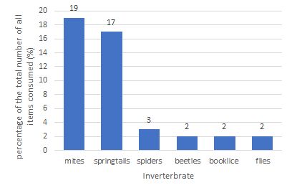
Diet in 10 sites of Hawai‘i
Notes:
Capable of securing and ingesting a wide range of food
(https://www.cabi.org/isc/datasheet/84737#todistribution)
Found to primarily consume leaf-litter invertebrates
Estimated to consume up to 129,000 invertebrates ha⁻¹ night⁻¹

Slide 6

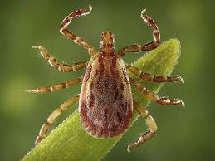
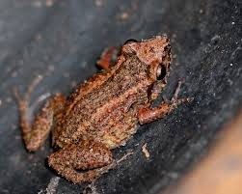
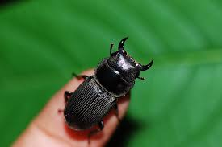

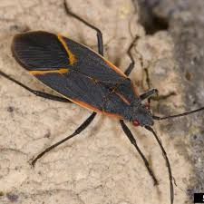
Diet at different stage classes
change to graphic
蜱蟎亞綱 (Acari)
蜱蟎亞綱 (Acari)
Adult
Preadult
甲蟲 (Coleoptera / beetle)
彈尾目(Collembola)
異翅亞目(Heteroptera / true bugs)
Notes:
No. of items consumed affected by site and stage class
Preadults consume more Acari and Collembola (smaller in size)
Adult female consume more Coleoptera and Heteroptera (larger in size)
Adult males: Acari

Slide 7
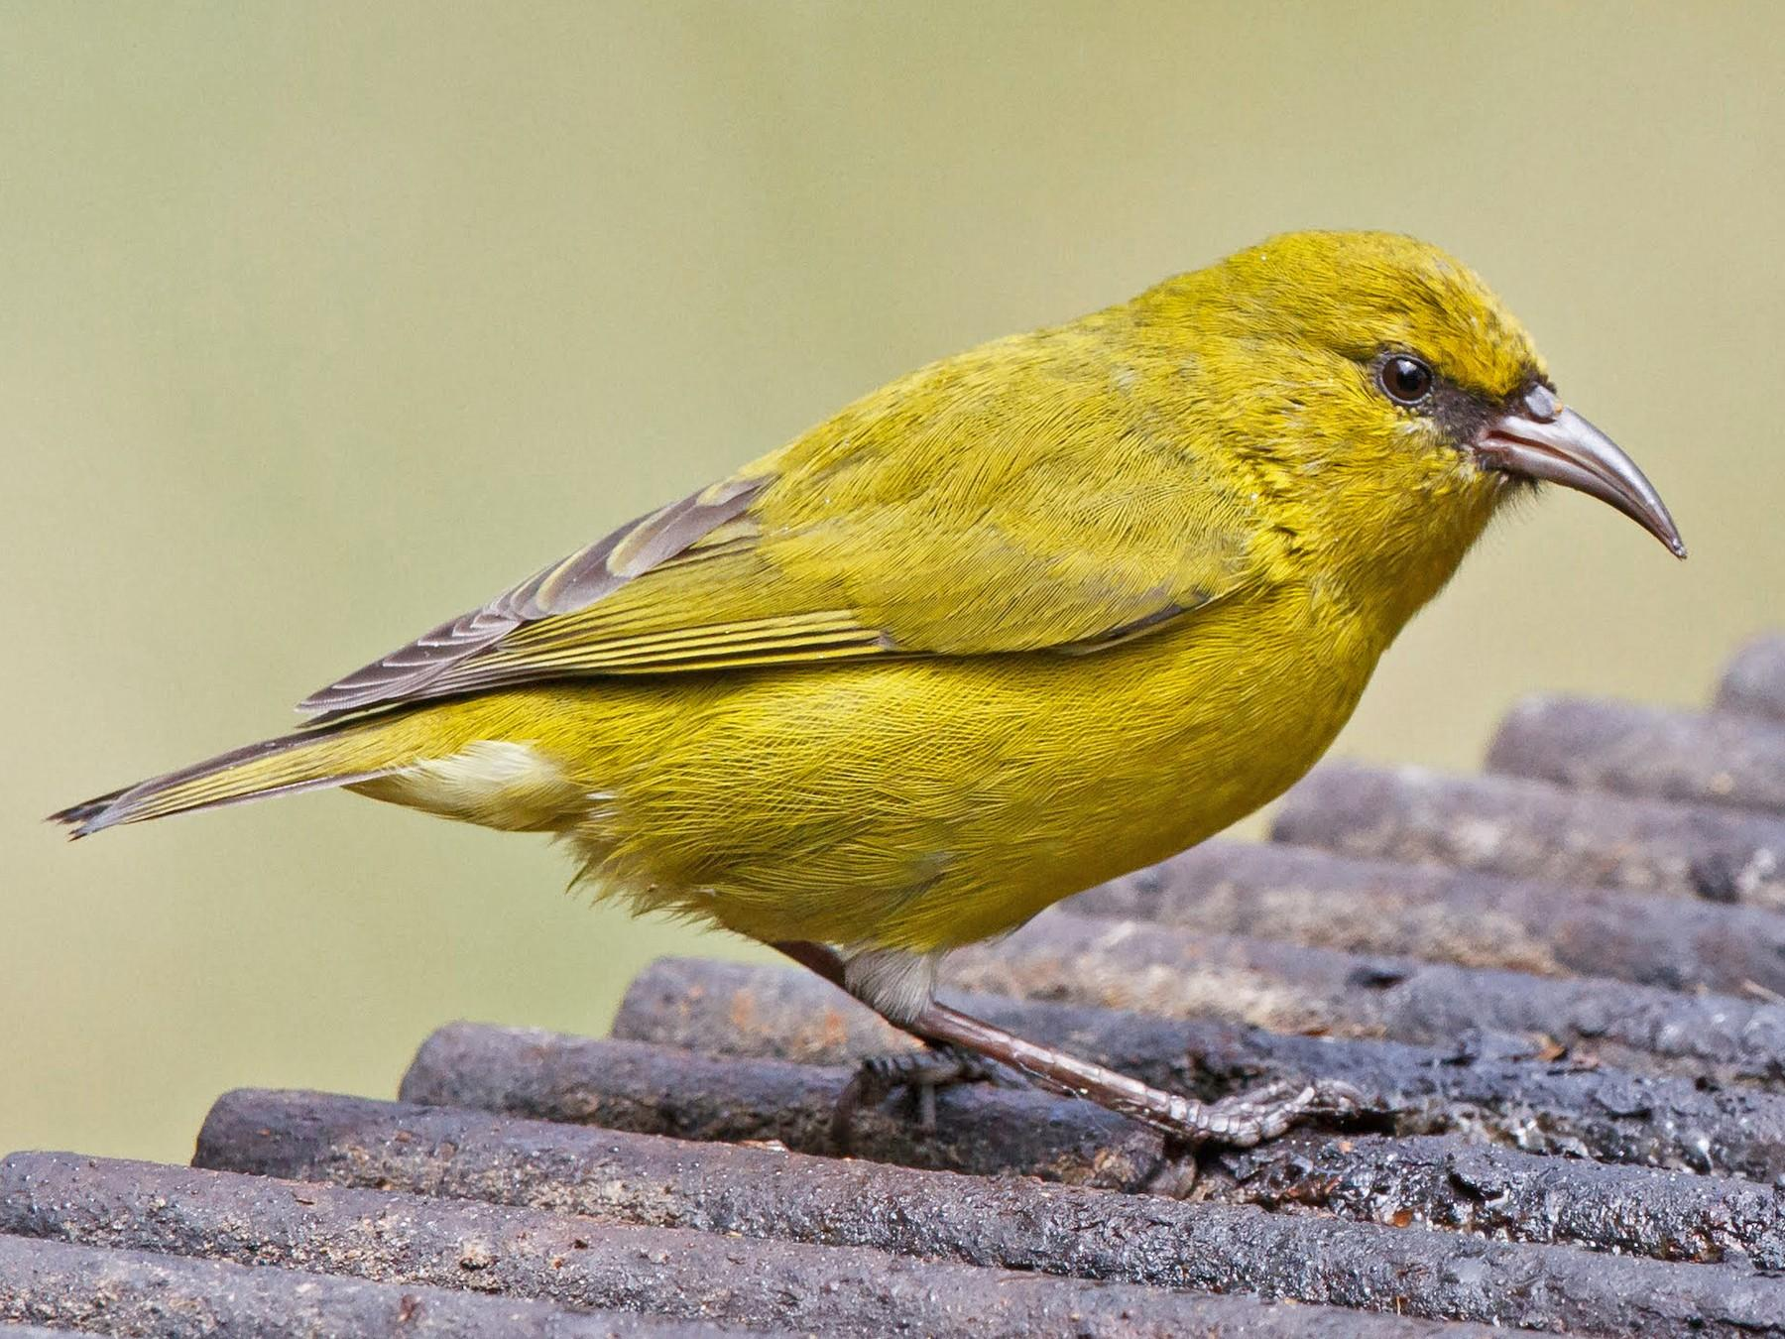
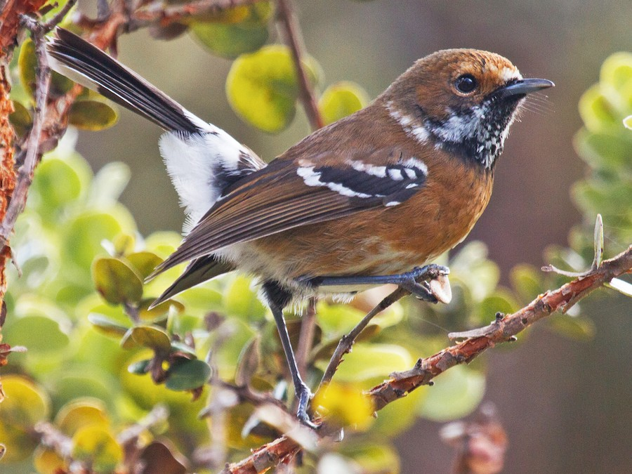
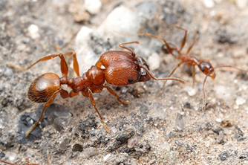
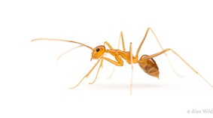
Biological impact
example of birds
Endemic birds in Hawai‘i
Nonnative invertebrate orders comprised 43.2% of their diet, nonnative ant
May indirectly benefit native invertebrates which were probably consumed by nonnative ants
Hawai‘i ʻamakihi
LC
Hawai‘i ʻamakihi
VU
Big-headed ant
Yellow crazy ant

Slide 8
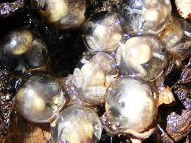
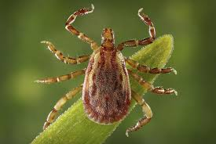
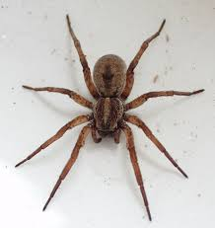
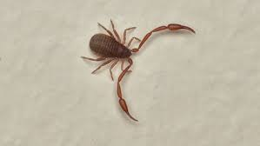
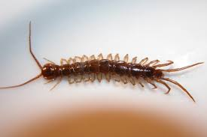
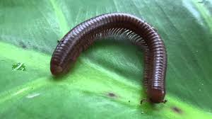
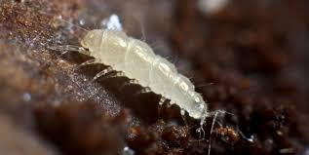
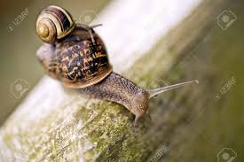
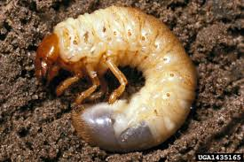
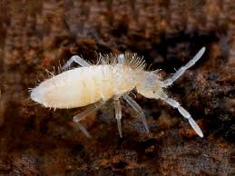
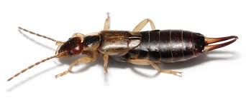

Slide 9
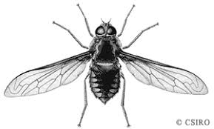
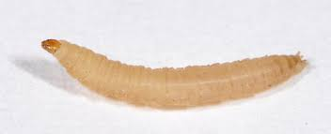
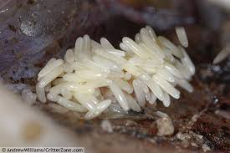
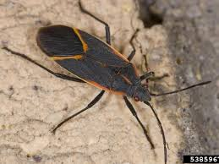
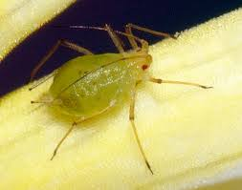
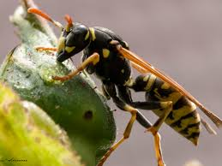
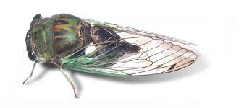
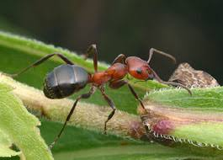
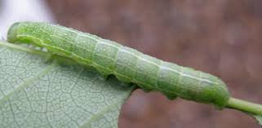
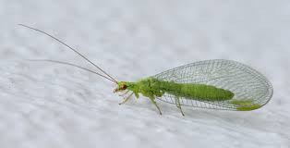
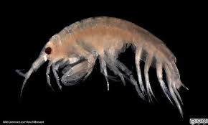
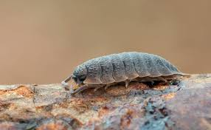
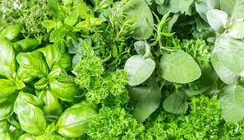
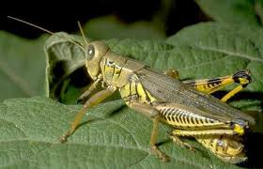
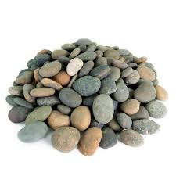
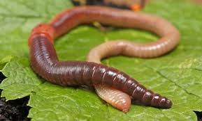

Slide 10



Slide 11

The greenhouse frog primarily consumes ants, mites, and springtails
Native invertebrates | Non-native invertebrates
Mites (19% of the total num- ber of all items consumed) | Ants (32%)
Springtails (17%) | Isopods (8%)
Spiders (3%) | Amphipods (1%)
Beetles (2%)
Flies (2%),
Notes:
3. Biology and Impacts of Pacific Island Invasive Species

Slide 12
Consumption of non-native species in Hawaii
Pheidole megacephala (Big-headed Ant) : 29% of the total diet
Linepithema humile (Argentine Ant) : 17% of the total diet
Anoplolepis gracilipes : 2 % of the total diet
Notes:
4. Diet of the Introduced Greenhouse Frog in Hawaii
8% of the consumed Isopoda were non-native
1% of the consumed Amphopoda were non-native
Total: 45% of the frog diets were non-native species to Hawaii

Slide 13

原生地與入侵地
(Schwartz 1974)
Cuba and the Bahamas that has invaded areas of the southeastern United States, Jamaica, and Guam, and five Hawaiian Islands: Hawaii, Kauai, Lanai. Maui, and Oahu (Kraus et al., 1999; Christy et al., 2007).
First recorded in Hawaii in 1994, arriving through the nursery trade
Estimated to consume up to 129,000 invertebrates ha⁻¹ night⁻¹
Notes:
Capable of securing and ingesting a wide range of food
(https://www.cabi.org/isc/datasheet/84737#todistribution)

Slide 14


Formicidae
蟻科
Collembola彈尾目
Acari
蜱蟎亞綱
Notes:
Collembola 彈尾目無翅，長在5毫米以下。善於跳躍, 雖然與昆蟲類似，但不再列入昆蟲類。
Acari 包括了蜱、蟎、疥瞞、恙蟎、寄蟎等物種，體型大多數比較細小，即使是最大的，也只有1cm的大小。

Slide 15






Microhabitat
change to picture
(micro habitat)
Leaf litter sample
Sticky trap
Vaccum
Outdoor Plant Nurseries
Natural Area
Resort
Agricultural Research Station
Macadamia Nut Orchards
Notes:
leaf litter from eight 0.25 x 0.25-m subplots, a minimum of 10 m apart, located randomly within a 100 x 100-m plot
Collected flying invertebrates on 10 x 18-cm sticky traps posted on stakes 10 cm above the forest floor. We randomly placed eight sticky traps, spaced a minimum of 10 m apart, within a 100 x 100-m plot for 48hr
we collected foliage invertebrates with the use of a modified insect vacuum, swept the insect vacuum across foliage below 0.50-m height of total time of 30 sec in each sub pot.

