Slide 1
温室蟾的數量 與 環境因素(environmental factors) 及生境(habitat)的關係
Group3

Slide 2
Environmental Factors
Temperature
Humidity
Rainfall
Photoperiod
Tolerance for higher temperatures
maximum:
36.4°C - 41.8°C
seasonal daily minimum:
4°C - 8°C
breeding:
23°C - 30°C
Tolerance for drier conditions
Breeding period limited to a wet season [Relative humidity 84%-100%]
→ fewer frogs in the wet season than in the dry season
Controls the timing of reproductive activity
Reproduction occurs in the rainy season:
high temperatures + high rainfalls keep the soil moisture
→ preventing desiccation of the eggs
Inversely related to fat bodies
Fat bodies:
as an energetic reserve for reproduction
→ inverse relationship to the gonadal cycle
main source of the lipids that are used in yolk synthesis for the development of offspring
Biology and Impacts of Pacific Island Invasive Species. 8. Eleutherodactylus planirostris, the Greenhouse Frog (Anura: Eleutherodactylidae) 2012
Iturriaga, M., Sanz, A., & Oliva, R. (2014). Seasonal reproduction of the greenhouse frog Eleutherodactylus planirostris (Anura: Eleutherodactylidae) in Havana, Cuba. South American Journal of Herpetology, 9(2), 142-150.
Notes:
Photoperiod: the period of time each day during which an organism receives illumination.
A gonad, sex gland, or reproductive gland is a mixed gland that produces the gametes (sex cells) and sex hormones of an organism.

Slide 3

Temperature | significant correlation: ambient temperature increases the metabolic rate → accelerating the conversion of energy stored in fat bodies for yolk synthesis. | insignificant correlation
Rainfall courtship activity most intense in early wet season a decline associated with egg-laying and nesting activity of females and perhaps reduced territoriality of males a modest resurgence of breeding in early dry season | Dry season: minimum relative ovarian mass high values of fats Wet season: maximum relative ovarian mass low values of fats | Dry season: testes show a regression stage relative testicular mass: monthly differences were not significant, although the greatest values in early-mid wet season
 |  | Calling required warm, humid, but not necessarily wet conditions peak reproductive activity in wet season
 | Bimodal vitellogenesis 1st wave from late dry to early wet season 2nd wave in late wet season Egg-laying in wet season | Spermatogenesis started in late dry season high activity in early-mid wet season ended in early dry season
Grow up into adults | as early as mid dry season | as early as late wet season
Meshaka, W., & Layne, J. (2005). Habitat relationships and seasonal activity of the greenhouse frog (eleutherodactylus planirostris) in southern Florida. Florida Scientist, 68(1), 35-43.
Iturriaga, M., Sanz, A., & Oliva, R. (2014). Seasonal reproduction of the greenhouse frog Eleutherodactylus planirostris (Anura: Eleutherodactylidae) in Havana, Cuba. South American Journal of Herpetology, 9(2), 142-150.
Notes:
vitellogenesis: the process by which the yolk is formed and accumulated in the ovum.
Spermatogenesis: the process by which haploid spermatozoa develop from germ cells in the seminiferous tubules of the testis.

Slide 4
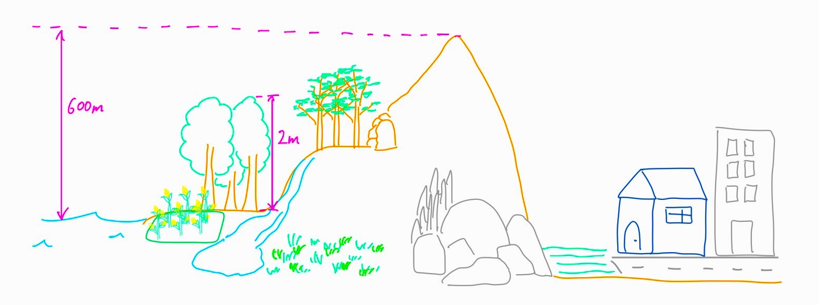
Habitat
low elevation areas
wide diversity of habitats (xeric, mesic)
wet and dry forests
mountainous areas
sea level - 600 m
forest floor - up to 2 m
caves
around buildings
rocky outcrops
rivers & stream-beds
agricultural areas
lawns
coastal areas
pastures
roadsides
Biology and Impacts of Pacific Island Invasive Species. 8. Eleutherodactylus planirostris, the Greenhouse Frog (Anura: Eleutherodactylidae) 2012
Meshaka, W., & Layne, J. (2005). Habitat relationships and seasonal activity of the greenhouse frog (eleutherodactylus planirostris) in southern Florida. Florida Scientist, 68(1), 35-43.
Notes:
typically found on the forest floor and up to 2 m off the ground, found only from sea level to 600 m
native & invaded range in graph
xeric: containing little moisture; very dry.
mesic: with a moderate or well-balanced supply of moisture
Outcrop: 突出的岩床

Slide 5
Habitat
Abundant in various man-altered lowland habitats
Standard rate of loss/Evaporative water loss = 2.3 (relatively low) → contribute to its utilization of xeric microhabitats
This indicates:
  some morphological or physiological water-conserving mechanisms not seen in the other species
OR
  the success of small frogs in finding sheltered areas of relatively low air velocity in the dehydration tubes
Its ability to occupy buildings may allow it to extend its range beyond the limits imposed by temperatures in natural habitats
Continued clearing of wooded areas and agricultural use of the land will favor the spread
Climatic warming is also a factor in the long-term trend in northward range expansion
Meshaka, W., & Layne, J. (2005). Habitat relationships and seasonal activity of the greenhouse frog (eleutherodactylus planirostris) in southern Florida. Florida Scientist, 68(1), 35-43.
Pough, F. H., Stewart, M. M., & Thomas, R. G. (1977). Physiological basis of habitat partitioning in Jamaican Eleutherodactylus. Oecologia, 27(4), 285–293.

